Slide 1
UNIT V
STEADY STATE STABILITY ANALYSIS

Slide 2
STABILITY
The tendency of a power system to develop restoring forces equal to or greater than the disturbing forces to maintain the state of equilibrium.
Ability to keep the machines in synchronism with another machine
1

Slide 3
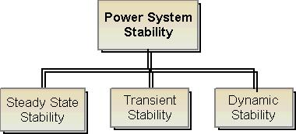
Classification Of Stability

Slide 4
Classification Of Stability
Steady state stability
Ability of the power system to regain synchronism after small and slow disturbances (like gradual power changes)
Dynamic stability
Ability of the power system to regain synchronism after small disturbances occurring for a long time (like changes in turbine speed, change in load)
Transient stability
This concern with sudden and large changes in the network conditions i.e. . sudden changes in application or removal of loads, line switching operating operations, line faults, or loss of excitation.

Slide 5
Steady State Stability Power Limit
Steady state limit is the maximum power that can be transferred without the system become unstable when the load in increased gradually under steady state conditions.

Slide 6
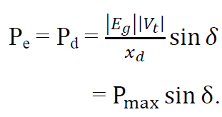
Transfer Reactance
steady-state power delivered by a lossless synchronous machine.
Where Xd is called transfer reactance

Slide 7
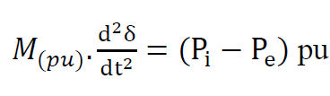
Synchronizing Power Coefficient
From swing equation
And

Slide 8
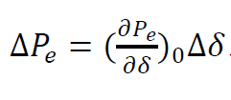
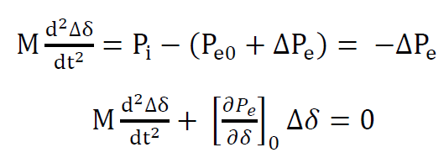

Synchronizing Power Coefficient
Linearizing the operating point
is called synchronizing power coeffincient.

Slide 9



Power Angle Curve
Swing equation is
The power flow equation of a single machine
connected to infinite bus (SMIB) system is given as
where

Slide 10

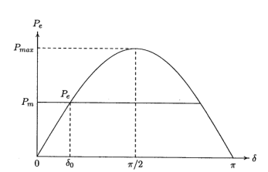
Power Angle Curve
Therefore
The curve Pe versus δ is called power angle curve

Slide 11
Methods to improve Stability
Use of Bundled Conductors
Use of Double-Circuit Lines
Operate Transmission Lines in Parallel
Series Compensation of the Lines
Series Compensation of the Lines
High-Speed Excitation Systems
Fast Switching
Breaking Resistors
Single-Pole Switching
HVDC Links
Load Shedding

